Slide 1
Roleplays

Slide 2
Testing

Slide 3
Career Cluster Exams
Business Management + Administration
Hospitality + Tourism
Entrepreneurship
Marketing
Finance

Slide 4
Business Admin + Management
Business Law and Ethics TDM
Human Resources Management Series
Principles of Business Management Admin

Slide 5
Hospitality and Tourism
Hospitality Services TDM
Hospitality and Tourism Professional Selling
Hotel and Lodging Management Series
Principles of Hospitality and Tourism
Restaurant and Food Service Management Series
Travel and Tourism TDM

Slide 6
Entrepreneurship
Entrepreneurship Series
Entrepreneurship TDM

Slide 7
Marketing
Apparel and Accessories Marketing Series
Automotive Services Marketing Series
Business Services Marketing Series
Food Marketing Series
Marketing Communications Series
Marketing Management TDM
Principles of Marketing
Professional Selling
Retail Merchandising series
Sport and Entertainment Marketing Series and TDM

Slide 8
Finance
Accounting Applications Series
Business Finance Series
Financial Consulting
Financial Services TDM
Principles of Finance

Slide 9
Performance Indicators
Examples:
Describe methods used to protect intellectual property
Explain types of business ownership
Explain the nature of tax regulations on business
Explain management's role in customer relations
Evaluate risk-taking opportunities

Slide 10
Solo vs. Team

Slide 11
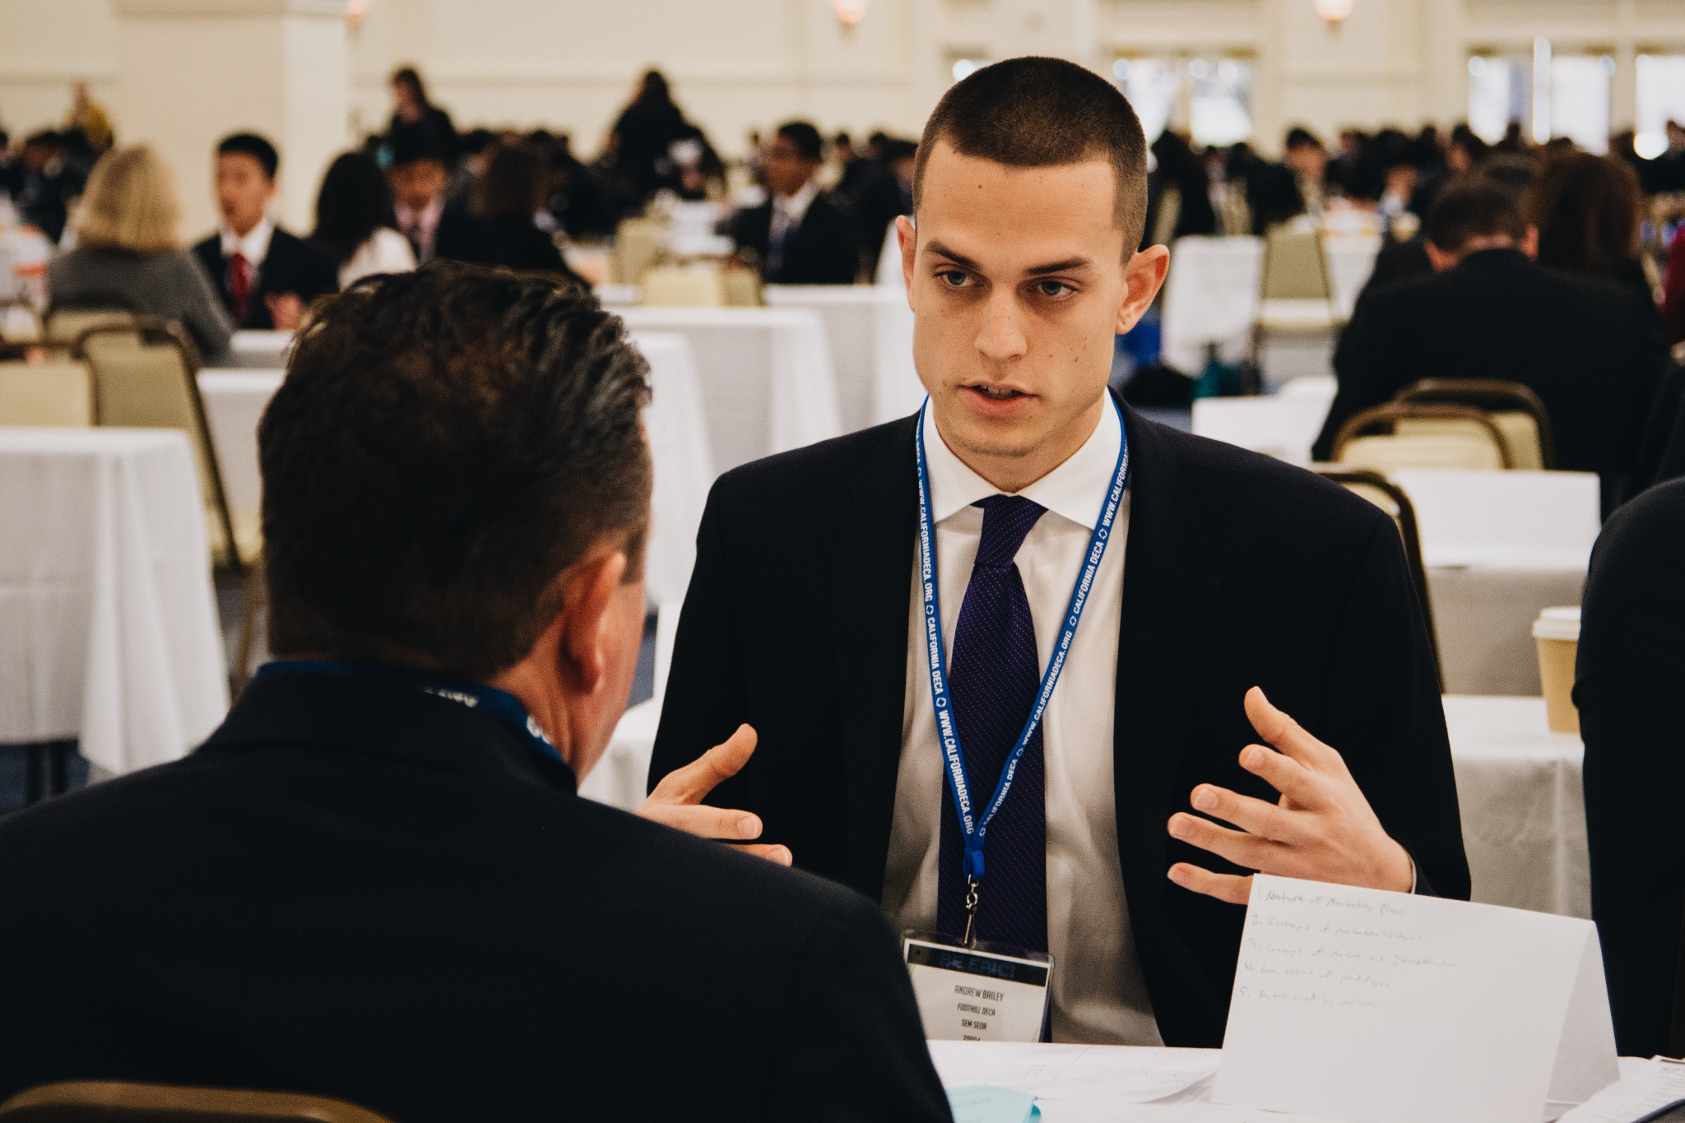
Individual Series
10 MINUTES
To review Case Study and use scrap paper to write down PIs and an outline of your presentation answering all the questions.
10 MINUTES
To present your ideas to the judge and answer the questions from the case study
5 MINUTES
To answer judge’s questions
Notes:
Kat

Slide 12
Team-Decision Making
30 MINUTES
To review Case Study and use scrap paper to write down PIs and an outline of your presentation answering all the questions with your partner
15 MINUTES
To present your ideas to the judge and answer any questions the judge has for you

Slide 13
Team Decision Making
Business Law and Ethics TDM
Buying and Merchandising TDM
Entrepreneurship TDM
Financial Services TDM
Hospitality Services TDM
Marketing Management TDM
Sports and Entertainment TDM
Travel and Tourism TDM

Slide 14
Professional Selling and Consulting
Financial Consulting
You are to assume the role of a financial consultant. Your client wants to buy a home but they are not sure if they qualify for a mortgage.
Hospitality and Tourism Professional Selling
You are to assume the role of a sales representative of a virtual running/race events company. You have a meeting with the director of tourism to present you ideas on how you can bring tourism to the city.
Professional Selling
You are to assume the role of a sales representative for a company providing health and safety auditing and consulting solutions. He/she wants to learn about your company’s products and services.

Slide 15
Grading- Solo
The maximum score for the evaluation is 100 points. The cluster exam and each role-play presentation will be valued at one-third (1/3) of the total score. In the final round of competition, the role-play presentation will be weighted twice (2 times) the value of the exam score. The exam score carries forward into the final round of competition.

Slide 16
Grading- TDM
The maximum score for the evaluation is 100 points. The presentation will be weighted twice (2 times) the value of the averaged exam score. The exam score carries forward into the final round of competition.

Slide 17
Prep Nights

Slide 18
Demonstration
Notes:
Emily: will narrate the process of roleplay
Gwen will pretend to take the test and Annalise
Gwen and Annalise are “partners” they will sit down and work on their “roleplay”. They will use scrap paper to make
business cards, graphs, tables, and pamphlets for their presentation.
Kat will pretend to be the judge.
Gwen and Kat will enter the room and greet Kat and sit down and do their presentation.

